Slide 1
Summary of: “Distributed Coordination Control of Multiagent Systems While Preserving Connectedness”
Written by: Meng Ji and Magnus Egerstedt
Presented by: Landon Shumway
[1]
M. Ji and M. Egerstedt, “Distributed Coordination Control of Multiagent Systems While Preserving Connectedness,” IEEE Transactions on Robotics, vol. 23, no. 4, pp. 693–703, Aug. 2007, doi: 10.1109/TRO.2007.900638.

Slide 2
Outline
Problem (graph connectedness)
Background literature
Solution
In the context of rendezvous problems
Simulation results
In the context of formation control problems
Simulation results
In the context of hybrid rendezvous-formation control problems
Summary
Future Work

Slide 3
Motivation
What is the problem being solved?
Connectedness issue: maintaining connection at all times in a group of mobile agents while they carry out some performance objective with limited sensing and communication ranges
Paper focuses on formation control and rendezvous problems
Formation control: maintaining a local formation between agents as the body of agents moves
Rendezvous problem: agents converge toward one location
These problems are considered solved assuming:
Connectedness at all times
If connectedness is only required at distinct times
“Sensing” and “movement” phases (connection is only needed during sensing phase
Can we ensure that connection is maintained at all times, negating the need for separate sensing and movement phases?

Slide 4
Relevant Background Literature
Formation control:
Leader-follower:
J. Desai, J. Ostrowski, and V. Kumar, “Controlling formations of multiple mobile robots,” in Proc. IEEE Int. Conf. Robot. Autom., Leuven, Belgium, 1998, pp. 2864–2869.
M. Egerstedt, X. Hu, and A. Stotsky, “Control of mobile platforms using a virtual vehicle approach,” IEEE Trans. Autom. Control, vol. 46, no. 46, pp. 1777–1782, Nov. 2001.
M. Egerstedt and X. Hu, “Formation constrained multi-agent control,” IEEE Trans. Robot. Autom., vol. 17, no. 6, pp. 947–951, Dec. 2001.
Leaderless:
T. Balch and R. C. Arkin, “Behavior-based formation control for multirobot teams,” IEEE Trans. Robot. Autom., vol. 14, no. 6, pp. 926–939, Dec. 1998.
J. Lawton, R. Beard, and B. Young, “A decentralized approach to formation maneuvers,” IEEE Trans. Robot. Autom., vol. 19, no. 6, pp. 933–941, Dec. 2003.
Rendezvous or formation control assuming connectedness:
J. A. Fax and R. M. Murray, “Graph laplacian and stabilization of vehicle formations,” in Proc. 15th IFAC, 2002, pp. 283–288.
Z. Lin, M. Broucke, and B. Francis, “Local control strategies for groups of mobile autonomous agents,” IEEE Trans. Autom. Control, vol. 49, no. 4, pp. 622–629, Apr 2004.
H. Tanner, A. Jadbabaie, and G. Pappas, “Stable flocking of mobile agents, part II : Dynamic topology,” in Proc. 42nd IEEE Conf. Decision Control, Maui, HI, Dec.2003, pp. 2016–2021.
Rendezvous or formation control assuming connectedness at discrete times:
H. Ando, Y. Oasa, I. Suzuki, and M. Yamashita, “Distributed memoryless point convergence algorithm for mobile robots with limited visibility,” IEEE Trans. Robot. Autom., vol. 15, no. 5, pp. 818–828, Oct. 1999.
A. Jadbabaie, J. Lin, and A. S. Morse, “Coordination of groups of mobile autonomous agents using nearest neighbor rules,” IEEE Trans. Autom. Control, vol. 48, no. 6, pp. 988–1001, Jun. 2003.
J. Cort ́ es, S. Martı ́nez, and F. Bullo, “Robust rendezvous for mobile autonomous agents via proximity graphs in d dimension,” IEEE Trans. Robot. Autom., vol. 51, no. 8, pp. 1289–1298, Aug. 2006.
L. Moreau, “Stability of multiagent systems with time-dependent communication links,” IEEE Trans. Autom. Control, vol. 50, no. 2, pp. 169–182, Feb. 2005.

Slide 5
Relevant Background Literature
Consensus or agreement problems utilizing the graph Laplacian
J. Fax and R. Murray, “Information flow and cooperative control of vehicle formations,” IEEE Trans. Autom. Control, vol. 49, no. 9, pp. 1465–1476, Sep. 2004.
R. Olfati-Saber and R. M. Murray, “Flocking with obstacle avoidance: Cooperation with limited communication in mobile networks,” in Proc. 42nd IEEE Conf. Decision Control, vol. 2, Maui, HI, Dec. 2003, pp. 20222028.
R. Olfati-Saber and R. M. Murray, “Agreement problems in networks with directed graphs and switching toplogy,” in Proc. 42nd IEEE Conf. Decision Control, vol. 4, Maui, HI, Dec. 2003, pp. 41264132.
R. Olfati-Saber and R. M. Murray, “Consensus problems in networks of agents with switching topology and time-delays,” IEEE Trans. Autom. Control, vol. 49, no. 9, pp. 1520–1533, Sep. 2004.
Time-varying network topologies:
M. Mesbahi, “State-dependent graphs,” in Proc. 42nd IEEE Conf. Decision Control, Maui, HI, Dec. 2003, pp. 3058–3063.
M. Mesbahi, “On a dynamic extension of the theory of graphs,” in Proc. 2002 Am. Control Conf., 2002, vol. 2, pp. 1234–1239.
W. Ren and R. Beard, “Consensus of information under dynamically changing interaction topologies,” in Proc. Am. Control Conf., vol. 6, Jun. 30–Jul. 2, 2004, pp. 4939–4944.
R. Olfati-Saber and R. M. Murray, “Consensus problems in networks of agents with switching topology and time-delays,” IEEE Trans. Autom. Control, vol. 49, no. 9, pp. 1520–1533, Sep. 2004.
A. Jadbabaie, N. Motee, and M. Barahona, “On the stability of the Kuramoto model of coupled nonlinear oscillators,” in Proc. 2004 Am. Control Conf., 2004, pp. 4296–4301.

Slide 6
What contribution did these authors make that went beyond any prior research?
Prior research assumes graph is connected rather than proving that it’s connected
Method is presented that modifies control law to ensure that the graph stays connected for all times (negates the need for separate “sensing” and “movement” phases)

Slide 7
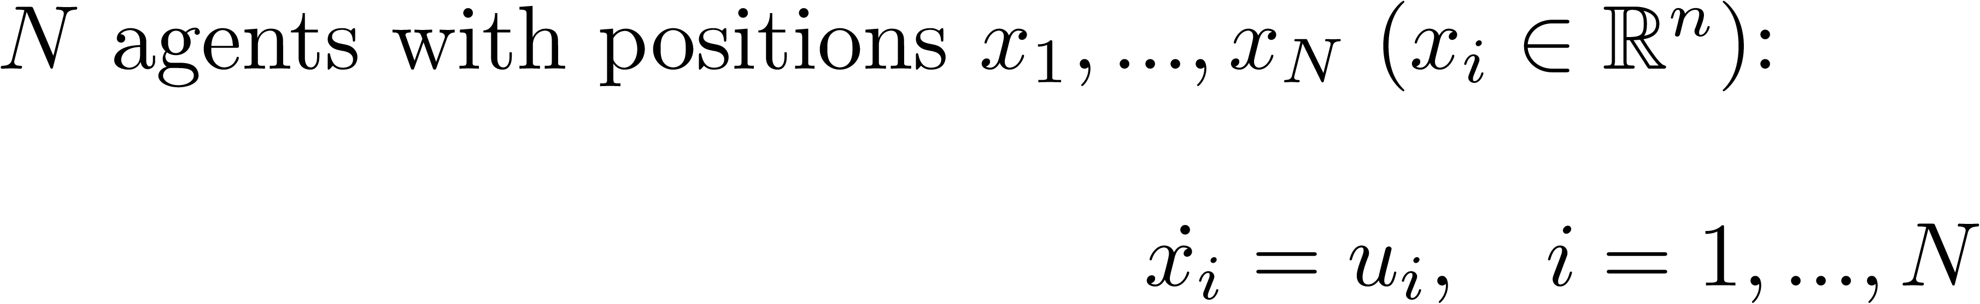
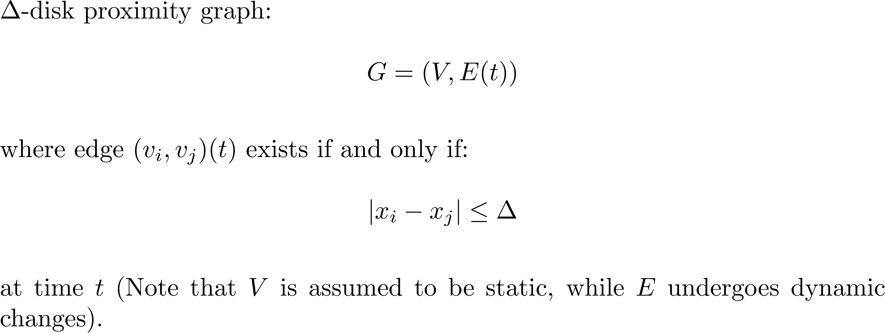
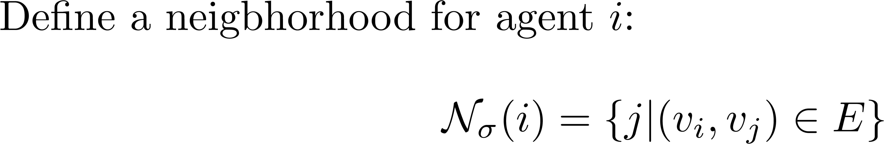
Model

Slide 8
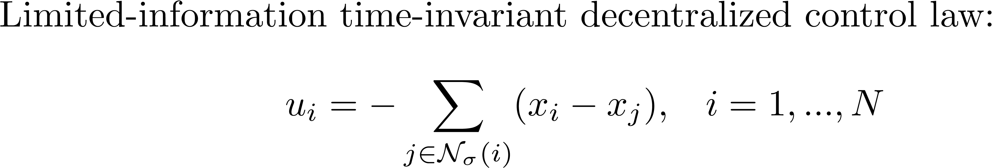
Simple Rendezvous

Slide 9
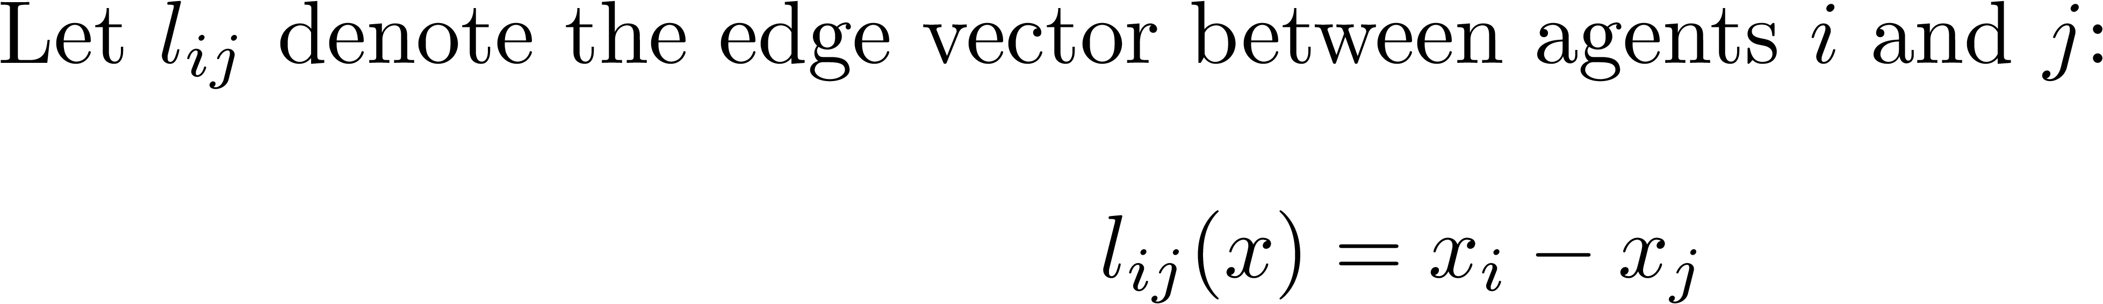
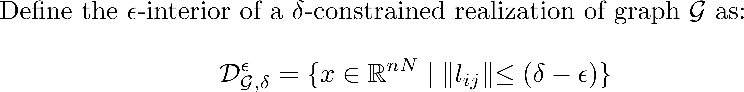
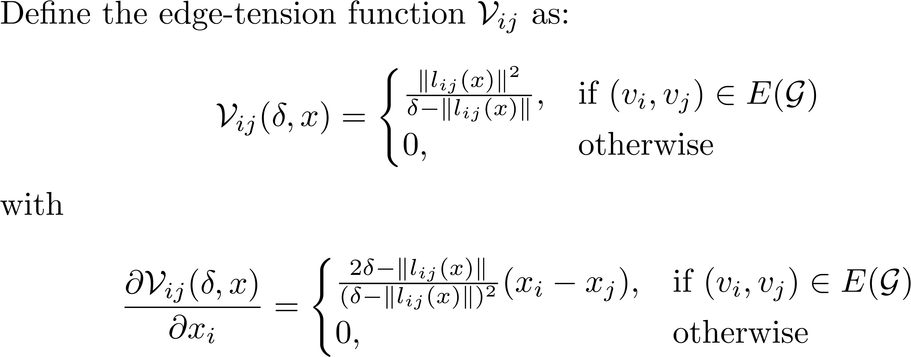
New Definitions

Slide 10
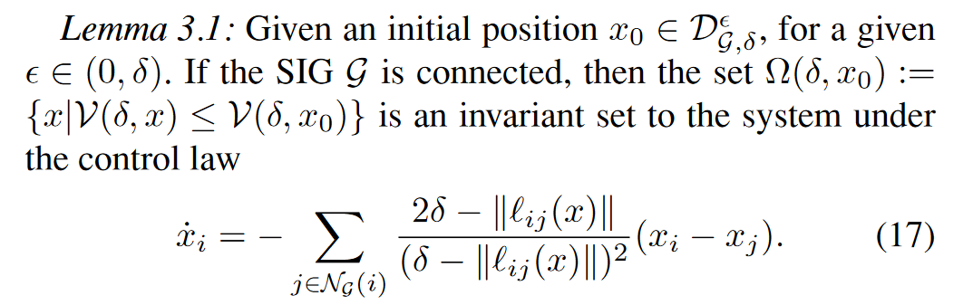
Lemma 3.1

Slide 11
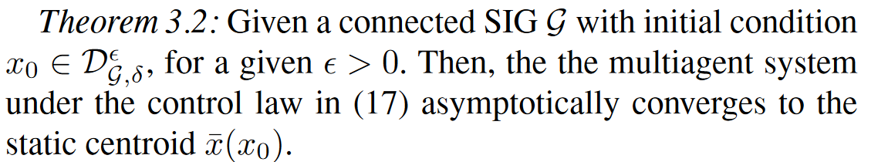
Theorem 3.2
Proof of this theorem involves LaSalle’s Invariance Principle to show that all solutions with the initial condition defined above converge to the centroid.

Slide 12
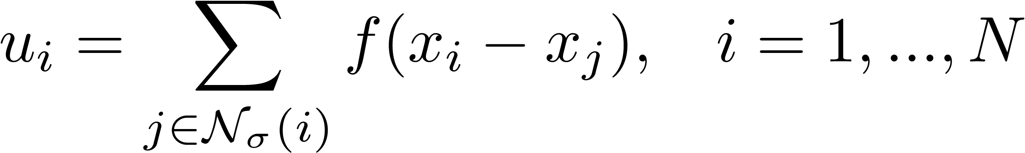
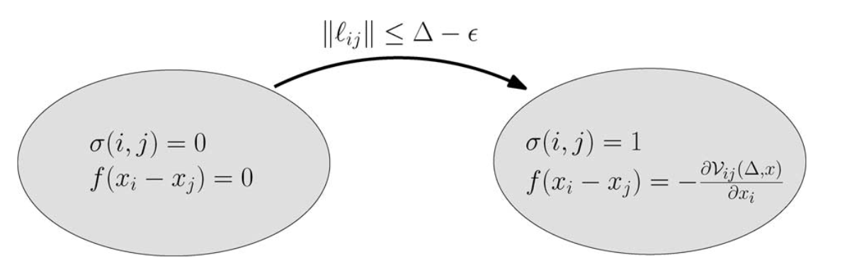
New and Improved Control Law

Slide 13
Why does this work?
From Lemma 3.1, we know that no edges will be lost from the starting graph
A.K.A. all agents that start within Δ - ϵ of each other will remain within Δ of each other for all future time
Two possibilities:
No new edges will be added to the graph
New edges will be added to the graph
From Theorem 3.2, we know that the system will converge to the centroid
As they converge, nodes that were not within Δ - ϵ of each other to start will eventually become within Δ - ϵ
Therefore, edges will be added until the graph is complete

Slide 14
Simulation results

Slide 15
Recap on Assumptions
Static nodes, dynamics edges in graph
Agents are homogeneous (same control laws govern the motion of all agents)
Edges can be weighted, but nodes are weighted equally
The graph starts connected (Δ - ϵ)

Slide 16
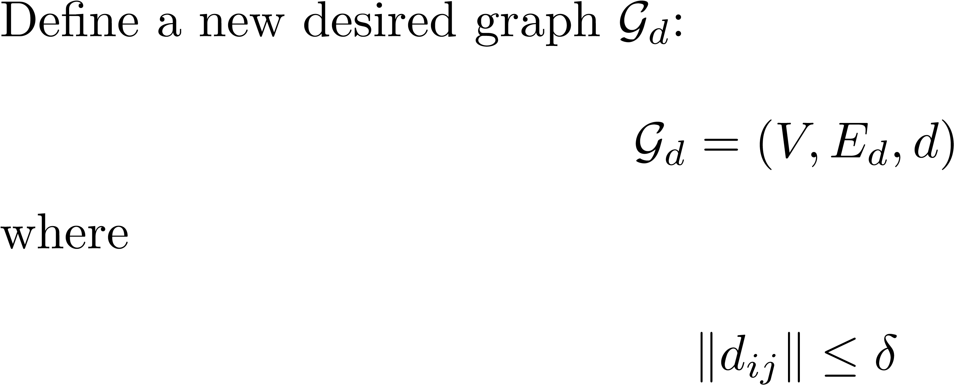
Formation Control
“The control objective is to drive the collection of autonomous mobile agents to a specific configuration such that their relative positions satisfy some desired topological and physical constraints”

Slide 17
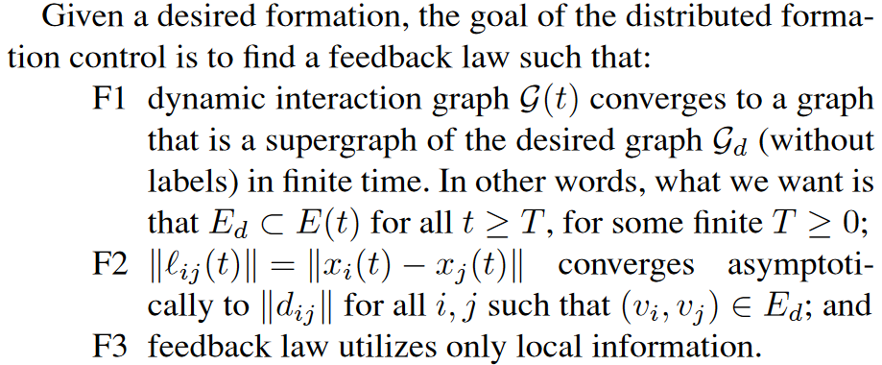
Formation Control
Assumptions:
No conflicting constraints (formation is geometrically possible)
Target formation is chosen in such a way that rigidity is obtained

Slide 18
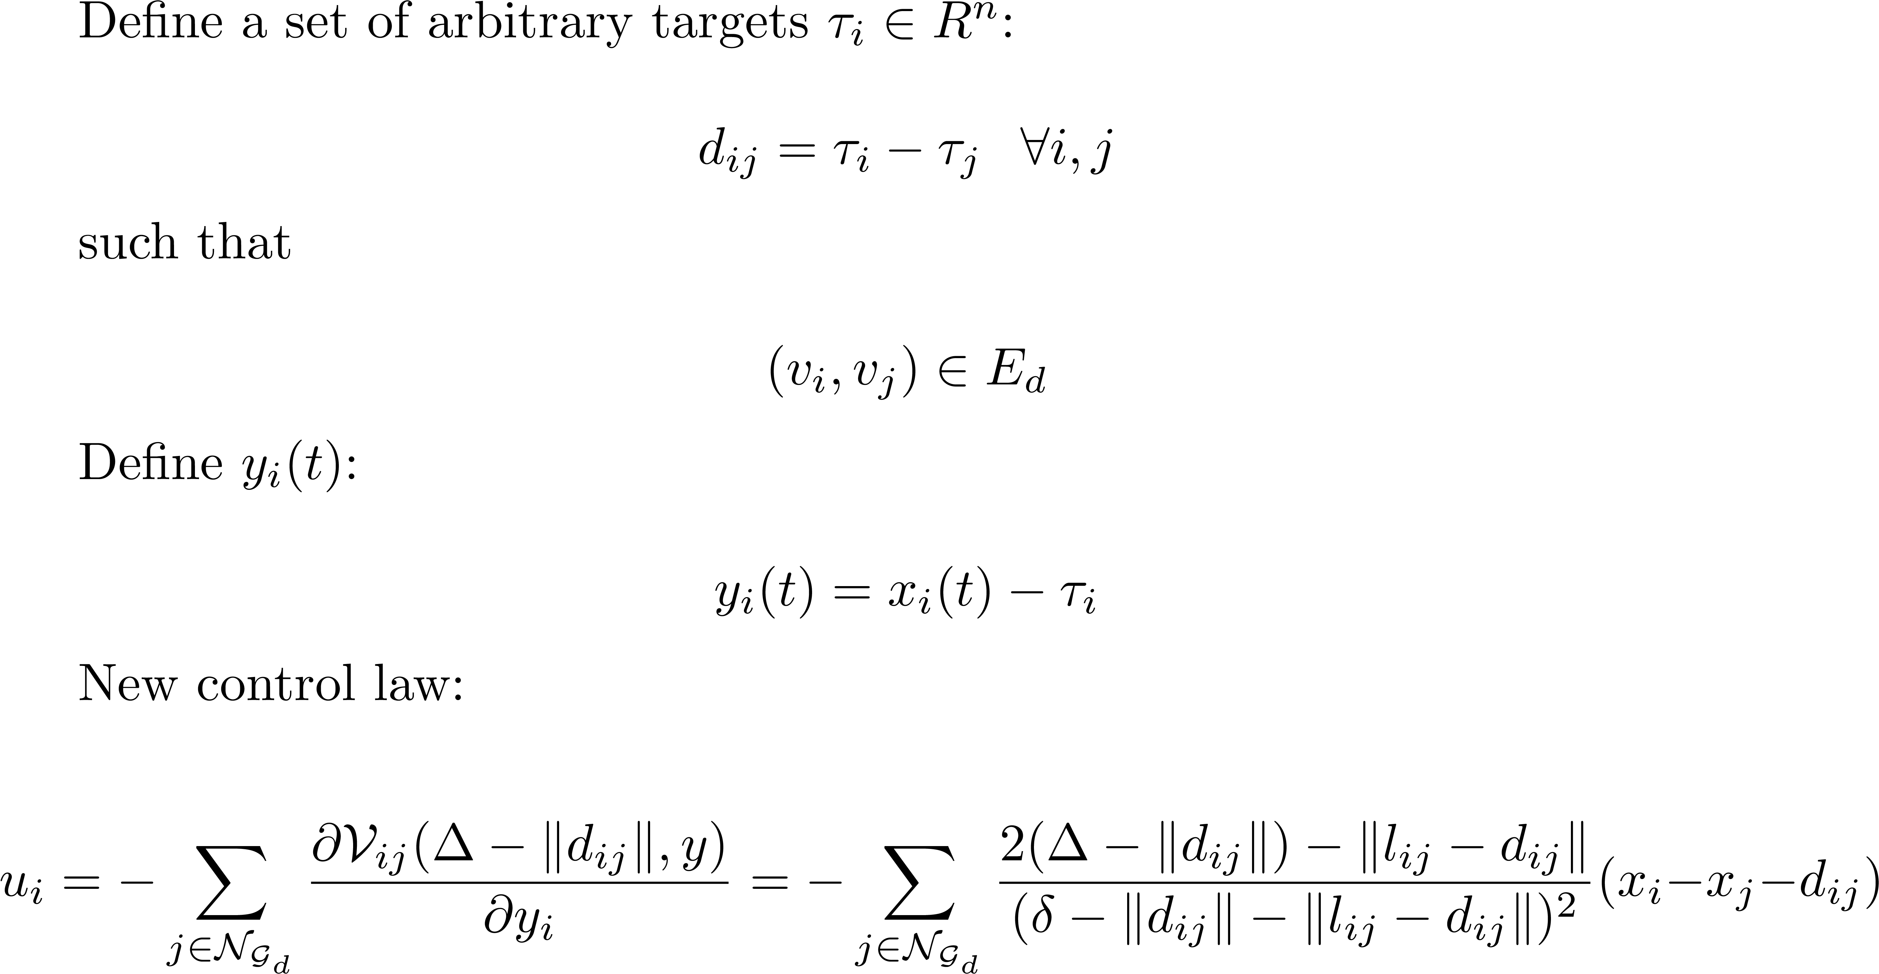
Formation Control

Slide 19
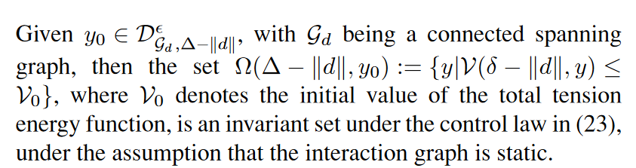
A Couple More Assumptions
The desired graph is a connected spanning graph of the initial graph
Meaning that all edges in the desired graph already exist in the initial graph
The desired graph (which influences the control law) is static
Only the “desired” edges are used, and those do not go away
Agents share the same coordinate system
Corollary 5.1 (similar to Lemma 3.1)

Slide 20
A couple more assumptions
The desired graph is a connected spanning graph of the initial graph
Meaning that all edges in the desired graph already exist in the initial graph
The desired graph (which influences the control law) is static
Only the “desired” edges are used, and those do not go away
Agents share the same coordinate system
Corollary 5.1 (similar to Lemma 3.1)

Slide 21
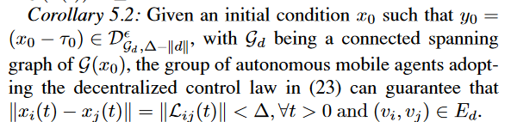
Corollaries 5.1 and 5.2
Corollary 5.1 (similar to Lemma 3.1)
Corollary 5.2:
AKA: if the desired graph starts as a spanning graph to the initial proximity Δ-disk graph, then it remains a spanning graph for all future time
AKA: edges that belong to the desired graph are never lost under the proposed control law

Slide 22

But does this converge to the desired formation?
(Similar proof to Theorem 3.2, which showed asymptotic convergence to the centroid for the rendezvous problem)

Slide 23
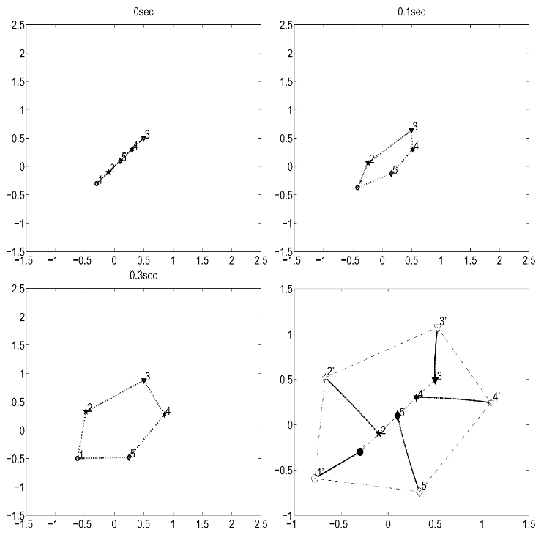
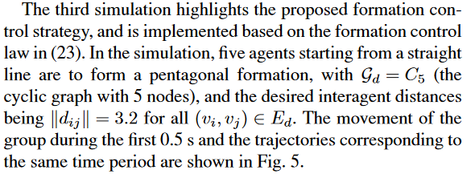
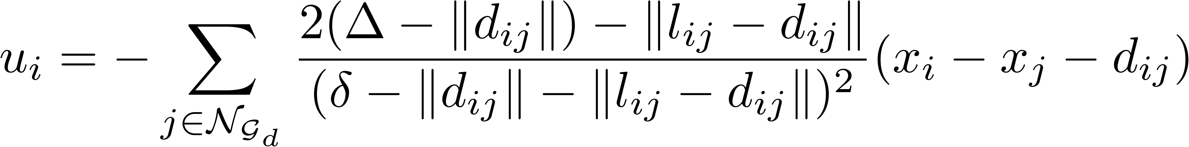
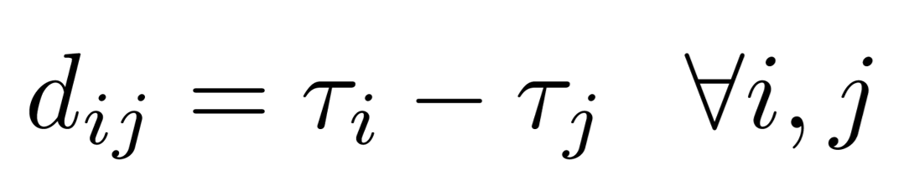
Simulation Results
Could not get simulation to work (very well)

Slide 24
Simulation Implementation

Slide 25
Addressing the Key Assumption
This formation control solution all hinges on the assumption that the desired graph is a connected spanning graph of the initial graph
How can we ensure that the graph starts out this way?
Solution: hybrid rendezvous-to-formation control
Rendezvous gathers the agents into a complete graph
State machine switches control from rendezvous to formation control

Slide 26
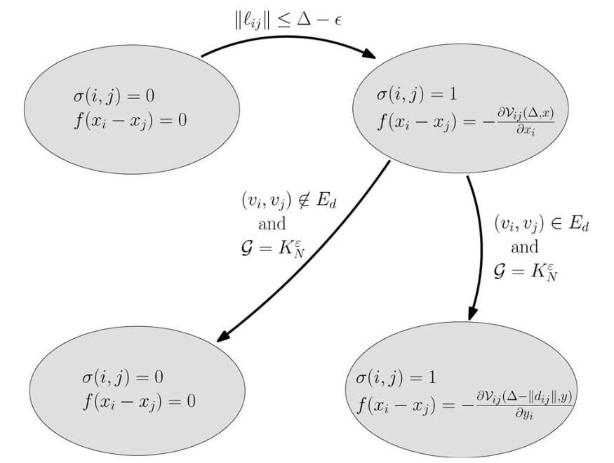
Hybrid State Machine
Rendezvous
Formation Control

Slide 27
De-centralized Switching Mechanism
Assumption: each node nodes the total number of nodes (N)
When a single node has N – 1 neighbors, and the distance between itself and its furthest neighbor is α/2, then all agents are within a distance of α of each other.
The node that recognizes this then broadcasts the switch to the other N – 1 nodes
Proof:
1
2
3
Note: the graph may become complete before this trigger occurs, but this method provides a de-centralized way to guarantee the graph is complete
α/2
α/2
α

Slide 28
Summary
Problem: Assuming rather than proving graph connectedness
Solution: Novel control laws for both rendezvous and formation control (and hybrid applications) that guarantee graph connectedness at all times
Simulation results: Rendezvous results were replicated without much difficulty, but the formation control seems to relay on known waypoint locations (rather than only relative distances)

Slide 29
Future Work
Formation control that is only dependent on relative information
Extension of application from 2D to 3D applications
Explore other de-centralized switching mechanisms (from rendezvous to formation control) that guarantee a complete graph quicker
Control laws that involve weighted nodes in addition to weighted edges

